Slide 1
Practice What You Learnt (Level 1)
- Rahul Soni

Slide 2
TASK 1
Represent the data as per the given criteria:
Represent the data, which includes the total count of account numbers against the country, in a tabular format.
Insert another table and represent the data on the country-wise Account holder's name.
Insert a slicer from the visualization section and add a country-wise filter.
Represent the data of India, Brazil, Greece, and France together.

Slide 3
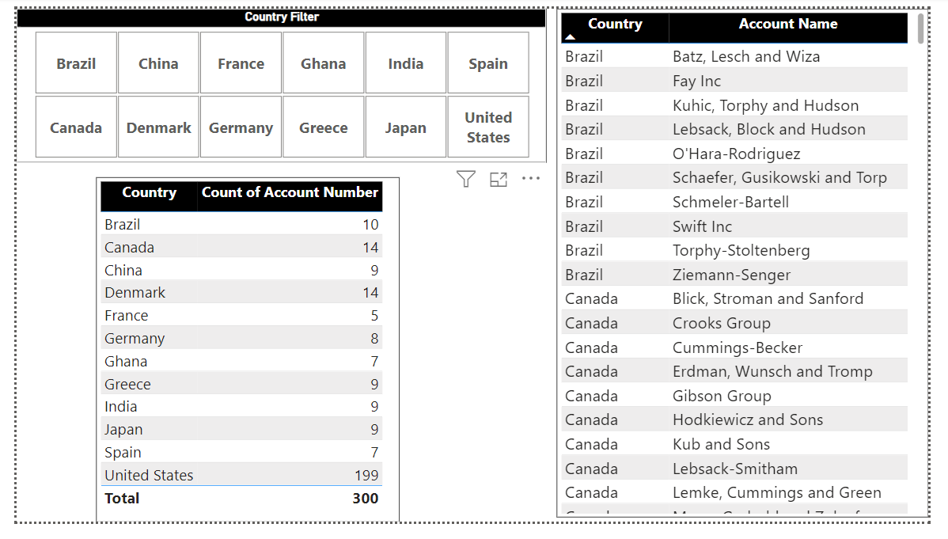

Slide 4
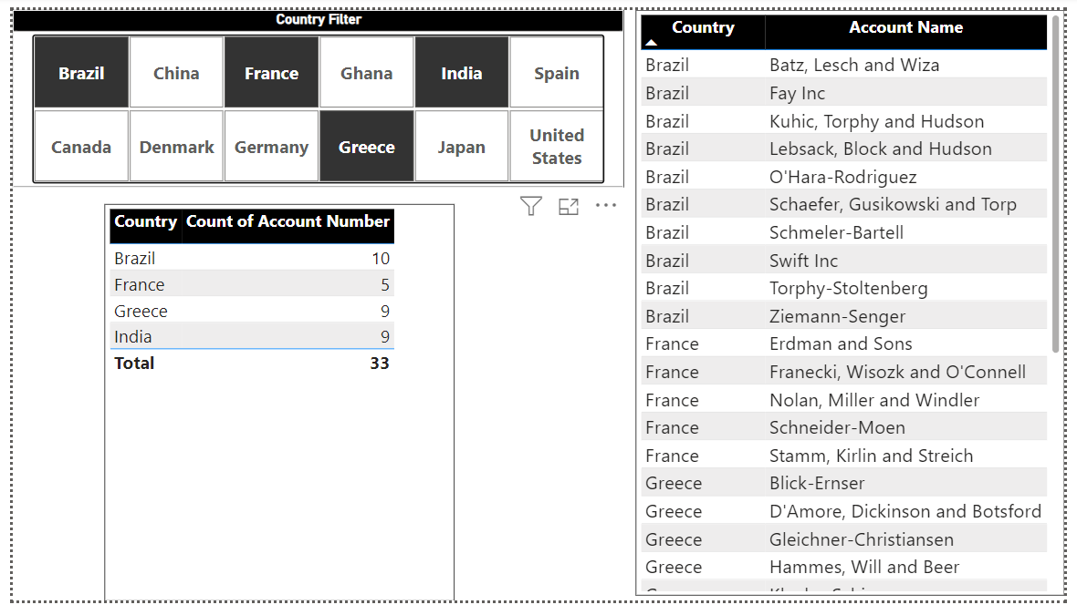

Slide 5
TASK 2
Represent the data as per the given criteria:
Country-wise industry and average profitability margin (in Percentage %)
Add a separate filter so that country-wise industry and profitability margins can be shown based on the selective countries (There is no bar on country selection).
Represent the following data using a pie chart:
Industry-wise profitability percentage
The data should be visualized in single or multiple country-wise
Present the data that shows industry-wise profitability trends by taking the Line & stacked column chart from the visualization section.
Present the data to show country-wise industry market values and industry-wise presence by taking the map chart.

Slide 6
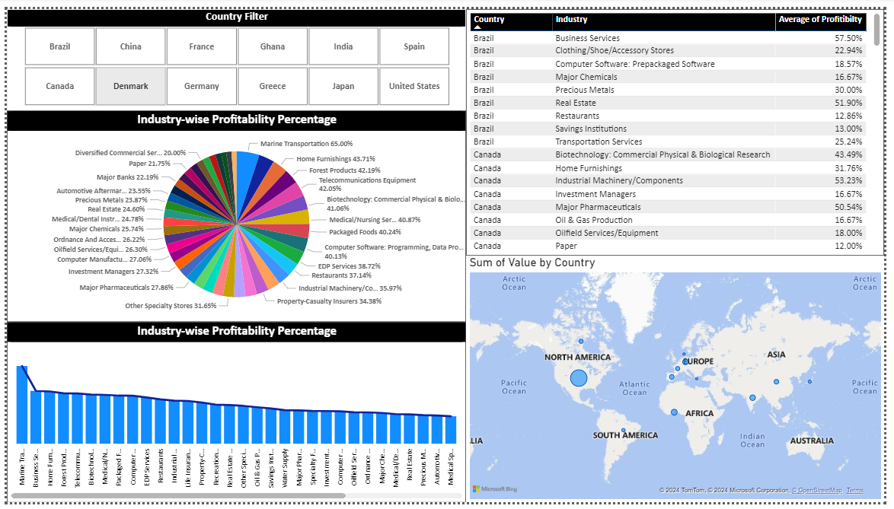

Slide 8
Practice What You Learnt (Level 2)
- Rahul Soni

Slide 9
TASK 1
Present the data following the below criteria by creating the relationships among three workbooks:
a. Region-wise number of customers
b. Region-wise number of Male & Female Customers
c. Customer presence throughout the world (based on the region-wise customer base)
d. Region-wise customer’s bank balance
e. Region-wise Monthly balance availability trend.

Slide 10
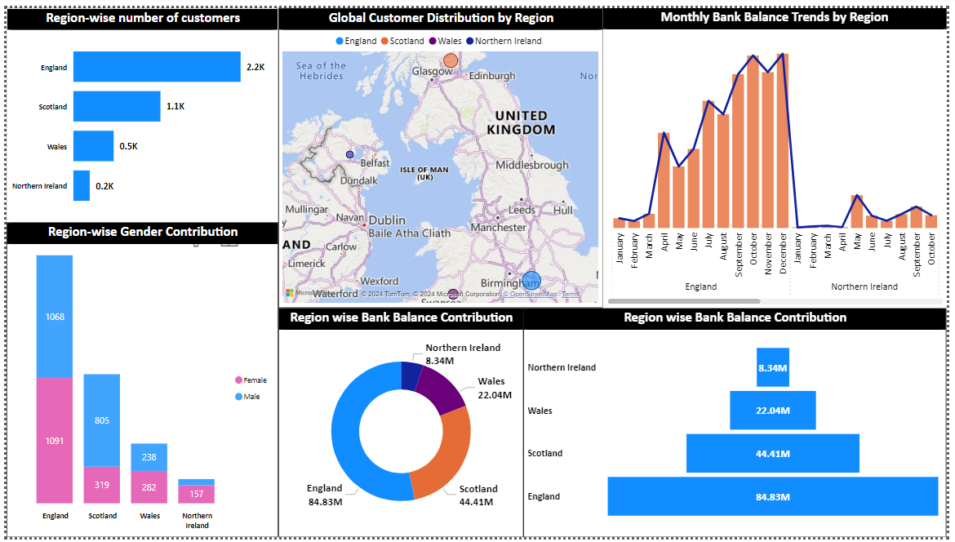

Slide 11
TASK 2
Represent the data as per the given criteria:
Overall profit percentage and commission for sales against each sales representative
Sales representative-wise total number of work shifts (monthly basis) and work shifts (day & night) trends against the sales representative
Identify the action items based on the analysis of the Sales Data and write them in the same document:
What are the areas you find for further improvement in terms of business product sales?
In which work shift does the sales representative mostly work?
Is there any additional impact you find in business in terms of product sales trends?

Slide 12
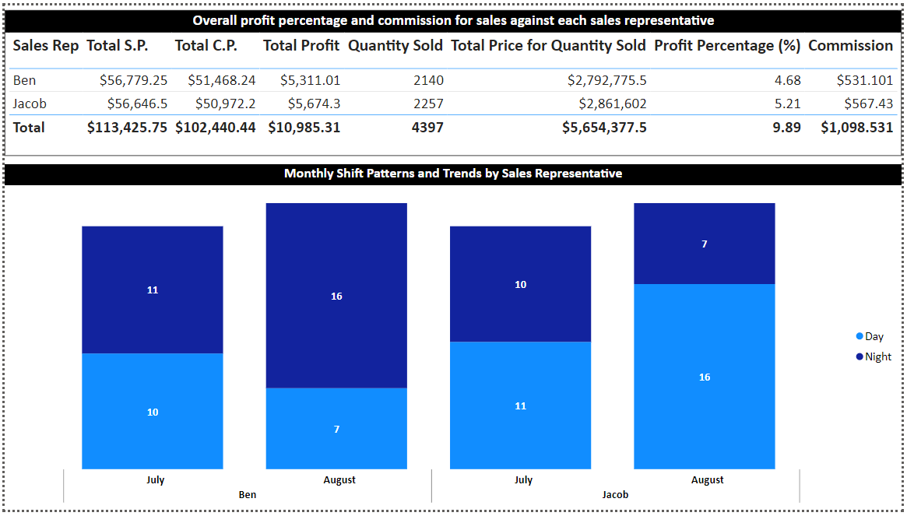

Slide 13
What are the areas you find for further improvement in terms of business product sales?
Areas for Further Improvement in Terms of Business Product Sales
Sales Performance Variability:
There is a noticeable variability in sales performance among different sales representatives.
For instance, Jacob tends to have more high-quantity sales than Ben. Analyzing and understanding the sales strategies used by Jacob could help improve overall sales performance.
Shift Performance:
Analyze the shift performance to understand which shifts contribute more to sales.
For example, Jacob has significantly high sales during the day shift, suggesting a potential strategy or customer preference for those hours.
Profit Margins:
While sales are strong, the profit margins (difference between selling price and cost price) vary.
Focus on products or sales tactics that yield higher profits, and consider adjusting pricing or sourcing strategies to improve margins.
High-Volume Sales Days:
Identify patterns or specific days that consistently show high sales volumes, and develop targeted marketing campaigns or promotions to boost sales on those days.

Slide 14
In which work shift does the sales representative mostly work?
Ben:
Ben works both day and night shifts but seems to have higher performance during the day shift with several high sales quantities.
Jacob:
Jacob predominantly works day shifts and shows a trend of higher sales quantities during these shifts. His performance during the night shift is also commendable but slightly lower in comparison to day shifts.

Slide 15
Is there any additional impact you find in business in terms of product sales trends?
Weekday Sales Trends:
Sales tend to peak on certain weekdays. For example, Fridays and Mondays often show high sales volumes. Understanding the reasons behind these trends (e.g., end-of-week shopping, beginning of the week necessities) could help tailor marketing strategies.
High-Sales Products:
Certain products show consistently high sales volumes. Identifying these products and ensuring they are well-stocked can prevent stockouts and lost sales opportunities.
Shift-Based Sales Strategies:
The sales performance varies between day and night shifts. Implementing shift-based sales strategies, such as special promotions or bonuses for night shift sales, could help balance sales performance across shifts.
Training and Best Practices:
Jacob's high performance indicates that he may have effective sales techniques that could be shared with other sales representatives. Organizing training sessions or creating best practice guidelines based on his methods could enhance overall sales team performance.

